Slide 1
TENNIS ELBOW
By:
SUMAN KUMARI
ASSISTANT PROFESSOR
DEPARTMENT OF B. VOCATIONAL SPORTS
NUTRITION AND PHYSIOTHERAPY
KANYA MAHAVIDYALAYA KARKHODA

Slide 2
Introduction : Tennis Elbow
Tennis elbow, or lateral epicondylitis, is a painful inflammation of the elbow joint caused by repetitive stress (overuse). The pain is located on the outside (lateral side) of the elbow, but may radiate down the back of your forearm. You’ll likely feel the pain when you straighten or fully extend your arm.

Slide 3
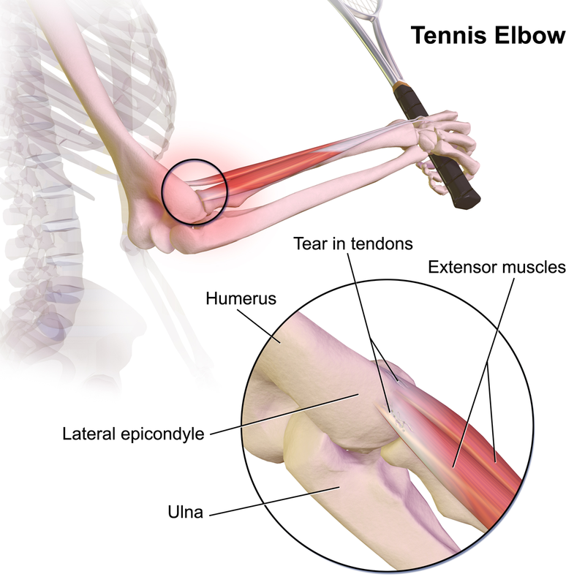
Discription of Tennis Elbow

Slide 4
Clinically Relevant Anatomy
The elbow joint is made up of three bones: the humerus (upper arm bone), the radius and ulna (two bones in the forearm). At the distal end of the humerus there are two epicondyles, one lateral (on the outside) and one medial (on the inside).
The area of maximal tenderness is usually an area just distal to the origin of the extensor muscles of the forearm at the lateral epicondyle. Most commonly, the extensor carpi radialis brevis (ECRB) is involved, but others may include the extensor digitorum, extensor carpi radialis longus (ECRL), and extensor carpi ulnaris.
The radial nerve is also in close proximity to this region, and divides into the superficial radial nerve and the posterior interosseous nerve.
Epidemiology/Aetiology

Slide 5
Causes
Tennis elbow can be triggered by any activity that involves repetitive twisting of the wrist. These activities may include:
tennis and other racquet sports
swimming
golfing
turning a key
frequently using a screwdriver, hammer, or computer

Slide 6
Symptoms
You may experience some of the following symptoms if you have tennis elbow:
elbow pain that is mild at first but gradually gets worse
pain extending from the outside of the elbow down to the forearm and wrist
a weak grip
increased pain when shaking hands or squeezing an object
pain when lifting something, using tools, or opening jars

Slide 7
Dignosis
Tennis elbow is usually diagnosed during a physical exam. Your doctor will ask you about your job, whether you play any sports, and how your symptoms developed. They will then perform some simple tests to help make a diagnosis. Your doctor may apply some pressure to the spot where the tendon attaches to the bone to check for pain. When the elbow is straight and the wrist is flexed (bent toward the palm side), you’ll feel pain along the outer side of the elbow as you extend (straighten) the wrist.
Your doctor may also order imaging tests, such as an X-ray or MRI scan, to rule out other disorders that can cause arm pain. These include arthritis of the elbow. These tests are not usually necessary to make a diagnosis.

Slide 8
Tennis elbow treatment
Rest
Nonsteroidal anti-inflammatory medicines
Physical therapy
Ultrasound therapy
Steroid injections

Slide 9
Physiotherapy Management
Education/Advice- on pain control and/or modification of activities
Exercises- Strengthening and Stretching
Modalities- Ultrasound, Transcutaneous electrical nerve stimulation (TENS)
Braces/Splints/Straps
Medications- NSAIDs offer a short term benefit (3-4 weeks pain relief)
Corticosteroids injection- Short term effect (6 weeks)
Sport/Occupation Specific Rehabilitation

Slide 10
Thank You

